Slide 1


Xamarin Forms
Challenge
Carl Barton
Jarley Software, LLC

Slide 2
What Is Xamarin?

Slide 3

Xamarin’s unique approach
iOS C# UI
Android C# UI
Windows C# UI
Shared C# logic
Shared C# codebase • 100% native API access • High performance
Notes:
Native, but in shared language
Thin Wrappers around native SDKs – UIViewController. Activity
As fast as native, feature parity easy, 70% shared code

Slide 4
Native User Interfaces
Native API Access
Native Performance
Notes:
Xamarin is Totally native
Controls/API/Performance

Slide 5





Native Clients in C#: Mobile, Mac, & Windows
.NET goes to every single client platform
Android C#
macOS C#
iOS C#
tvOS C#
Linux C#
Windows C#
Web
Shared C# Logic
Notes:
Can go further
Run same business logic on mobile, TV, linux, windows, mac, web
Even on a fridge - Tizen using Xamarin Forms

Slide 6
So…What Is Xamarin Forms?

Slide 7
Xamarin vs Xamarin.Forms
iOS C# UI
Android C# UI
Windows C# UI
Xamarin.Forms
Shared C# Logic
Shared C# Logic
Traditional Xamarin approach
With Xamarin.Forms: More code-sharing, all native
Notes:
Up to 90-95% code sharing

Slide 8
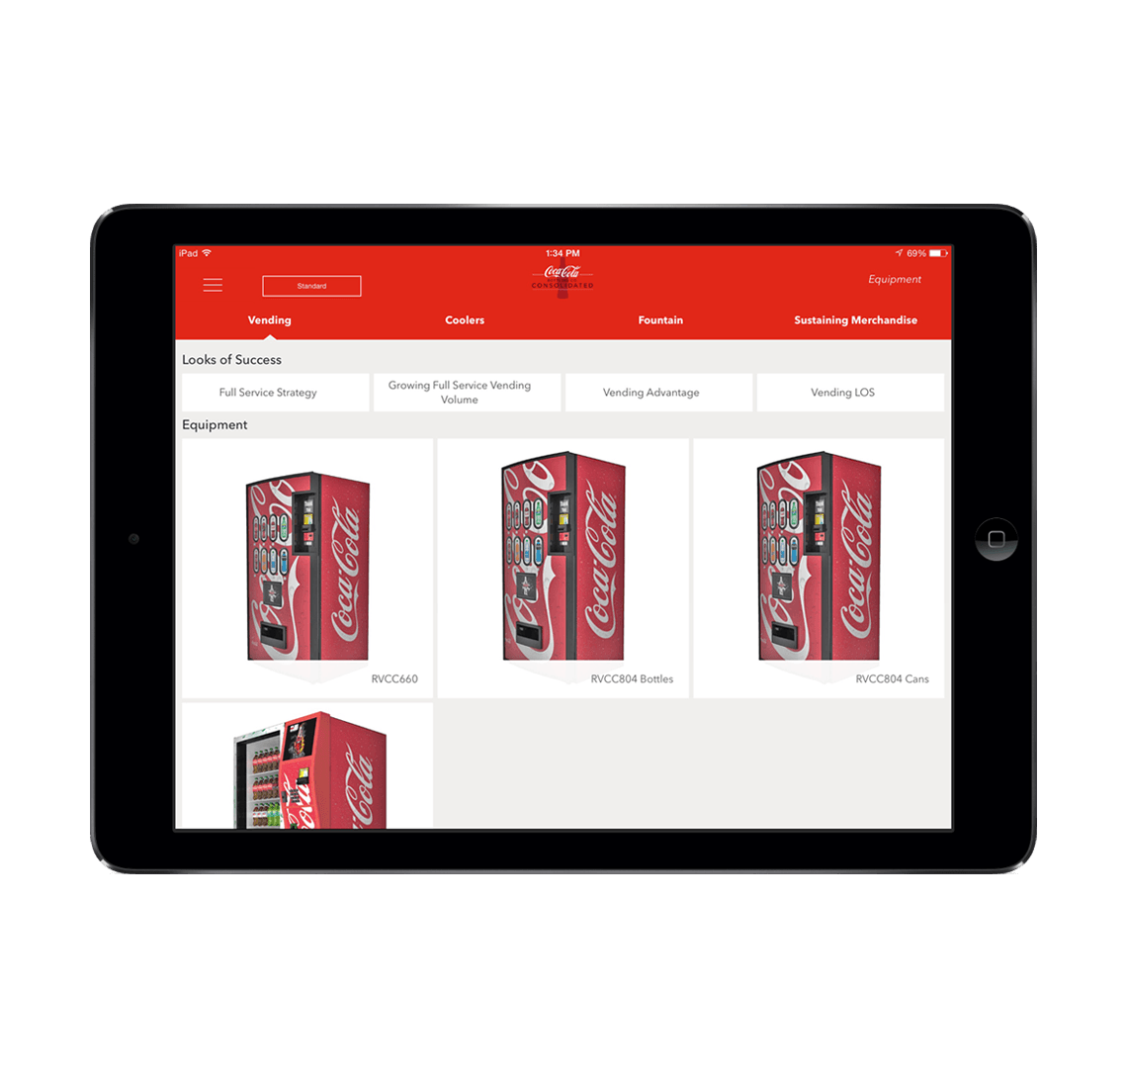
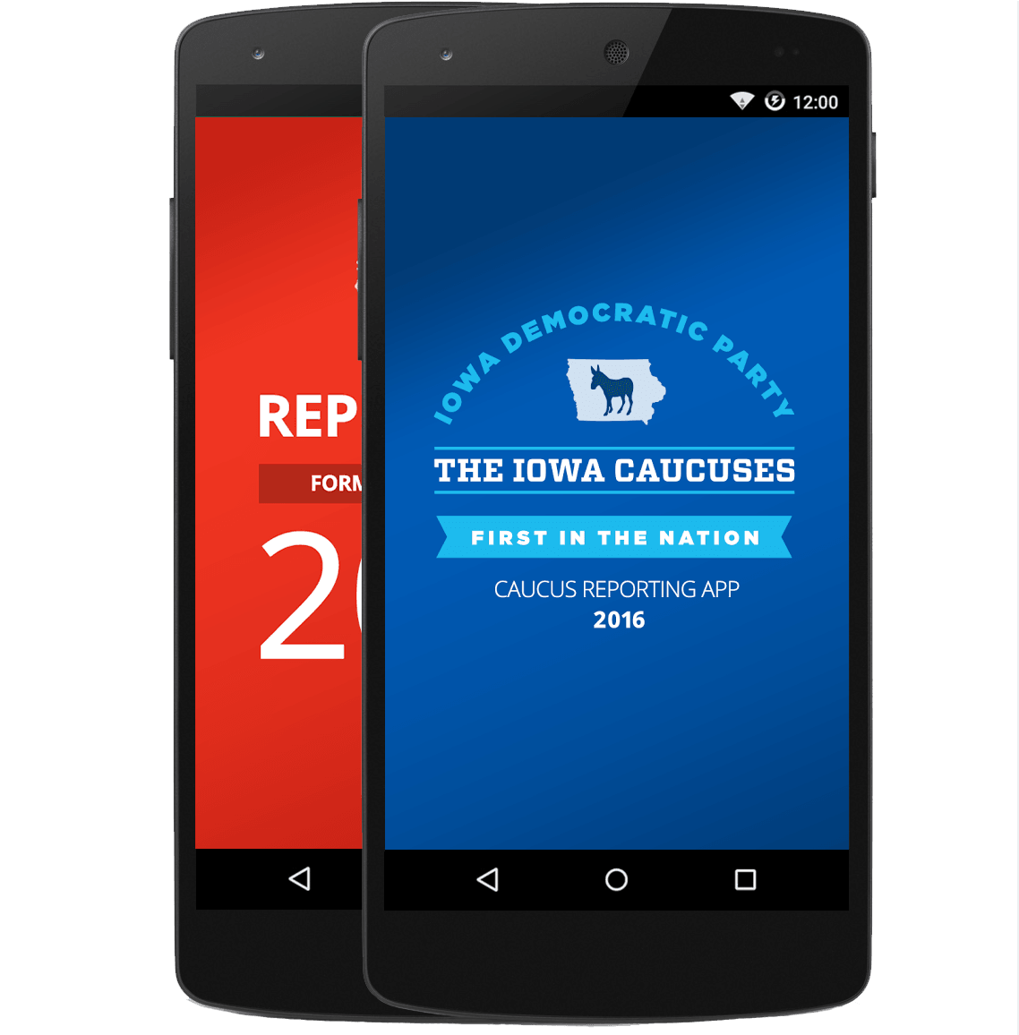
Xamarin.Forms—Cross Platform UI
Shared UI Code
Shared C# Logic
Shared Native User Interface
Shared App Logic
Notes:
Forms – originally designed for fast forms over data
Now powerful cross platform toolkit
Native – just an abstraction

Slide 9
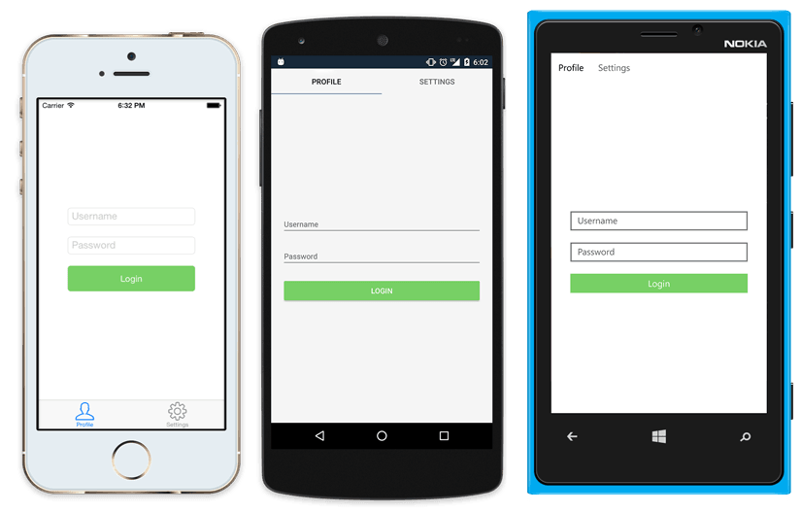
Native UI from shared code
<?xml version="1.0" encoding="UTF-8"?>
<TabbedPage xmlns="http://xamarin.com/schemas/2014/forms"
xmlns:x="http://schemas.microsoft.com/winfx/2009/xaml"
x:Class="MyApp.MainPage">
<TabbedPage.Children>
<ContentPage Title="Profile" Icon="Profile.png">
<StackLayout Spacing="20" Padding="20"
VerticalOptions="Center">
<Entry Placeholder="Username"
Text="{Binding Username}"/>
<Entry Placeholder="Password"
Text="{Binding Password}"
IsPassword="true"/>
<Button Text="Login" TextColor="White"
BackgroundColor="#77D065"
Command="{Binding LoginCommand}"/>
</StackLayout>
</ContentPage>
<ContentPage Title="Settings" Icon="Settings.png">
<!-- Settings -->
</ContentPage>
</TabbedPage.Children>
</TabbedPage>
Notes:
Native API access
Effects
Custom renderers

Slide 10
What’s included
✓ 40+ Pages, layouts, and controls
(Build from code behind or XAML)
✓ Two-way data binding
✓ Navigation
✓ Animation API
✓ Dependency Service
✓ Messaging Center
Shared UI Code
Shared C# Logic
Notes:
Pages, controls, navigation
Lowest common denominator, so just what is on all platforms
Full native API access – custom renderers, effects so can do everything

Slide 11
The Challenge…
What we will do:
Create a very basic “Hello World” app
Deploy to as many different targets as possible
What we will not do:
Platform-specific formatting for different form factors
App publishing requirements for various targets

Slide 12
Challenge Accepted…

Slide 13
Demo – File/New Project
Create the default Xamarin Forms Projects
Supports iOS, Android and Windows 10 UWP
Link to docs

Slide 14
Demo – Adding WPF Support
Create default WPF project
Add nuget packages and boilerplate app launch code
** Typical workflow for any additional platform
Link to docs

Slide 15
Demo – Adding macOS
Create default macOS project
Add nuget packages and app launch code
This one requires a bit more work…
Link to docs

Slide 16
Demo – Adding GTK#
Create default GTK# project (VS for Mac)
Add nuget packages and app launch code
Windows requires installation of GTK#
Can be created using MonoDevelop on Linux
Link to docs

Slide 17
Demo – Adding Ooui (Web)
Create an ASP.NET Core MVC App
Add Xamarin & Ooui nuget packages
Update Configure() in Startup
Update HomeController to return Xaml Page
Link to docs

Slide 18
Demo – Adding XboxOne
Use existing UWP project
Requires Xbox to be in Developer Mode
Setup Remote Debugging
** Should probably have its own project
Link to docs

Slide 19
Demo – Adding Tizen
Create a Tizen project
Install Tizen SDK, emulators and tools
TV requires 2018 Smart TV in Developer Mode
Link to docs

Slide 20
Demo –Amazon Fire TV
Use default Android project
Requires device in Developer Mode
Would be published to Amazon App Store rather than Google Play
Link to docs (Publishing)

Slide 21
Demo – Android Wear
Use default Android project (not ideal)
Recommend a separate Wear project
Link to docs

Slide 22
Wait! What about…
Apple Watch - docs
Apple TV - docs
Can share business logic but not UI.
It would require a separate session for each of these.

Slide 23
Q&A Github: https://github.com/JarleySoft/XFChallenge

Slide 24

Carl Barton
Jarley Software, LLC
@cbartonnh
cbartonnh@gmail.com
Getting started with Xamarin docs.microsoft.com/Xamarin

Slide 25

Thank you

